Slide 1
Virtual Card Platform
Logical Architecture

Slide 2
System Components
Client: User interface (app/website)
Server: Processes requests & contains business logic
DB (KYC): Stores user and card data
Provider: Issues cards and processes payments

Slide 3
How It Works Data Flow Example: Creating a Card
Request: User action in the Client.
Process: Server validates the request and checks data in the DB.
Execute: Server requests a new card from the Provider.
Store & Respond: New card details are saved in the DB and sent back to the Client.

Slide 4
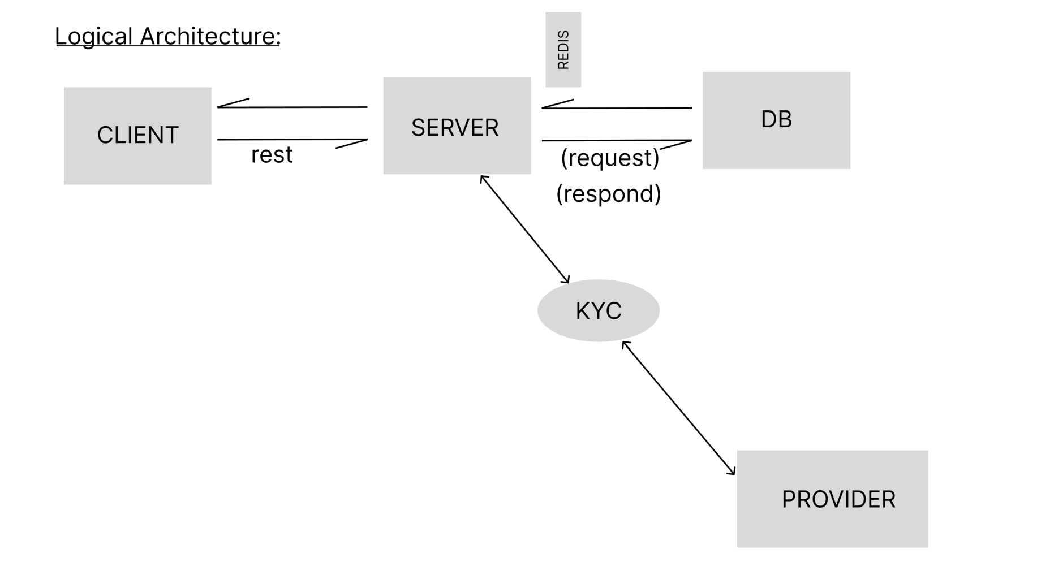
The Logical Architecture

Slide 5
Key Benefits
Modular: Components can be developed and scaled independently.
Secure: Centralized logic and secure data storage.
Flexible: Easy to update the client or change providers.

Slide 6
Thank You
Questions?

